Slide 1

Eagle Mountain-Saginaw Independent
School
District
1Q22
Demographic Report

Slide 2
Local Economic Conditions

Slide 3
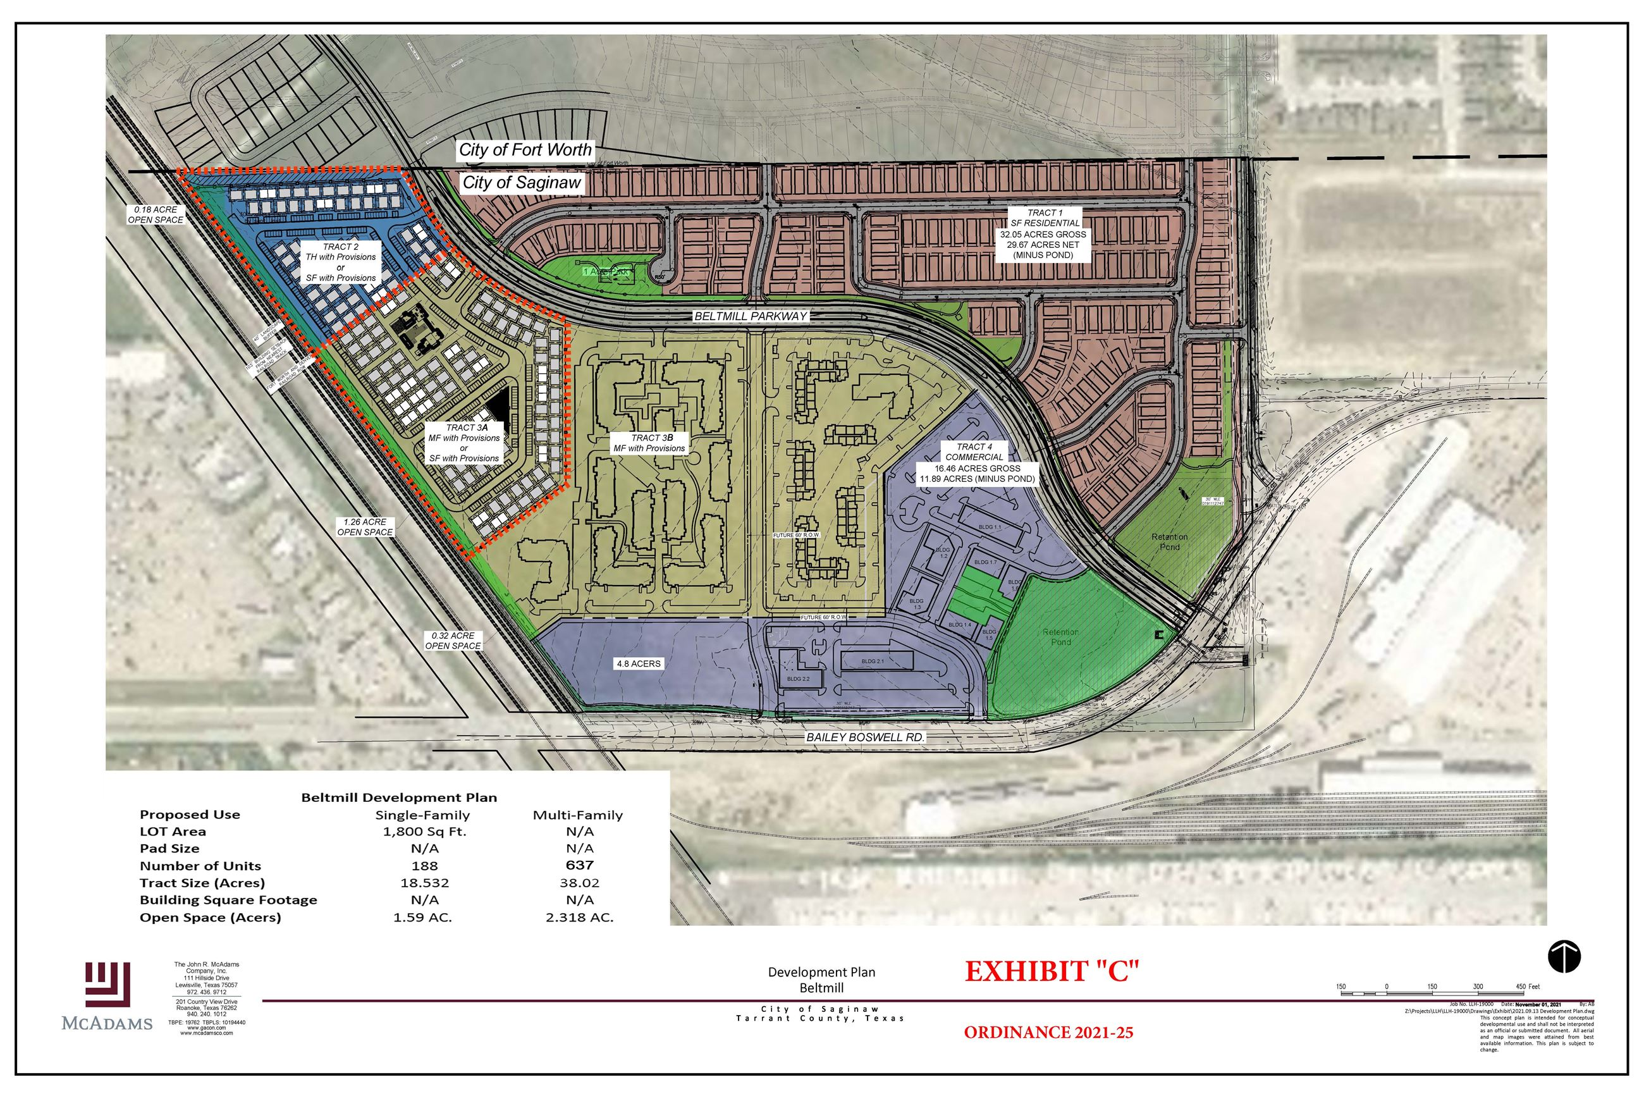
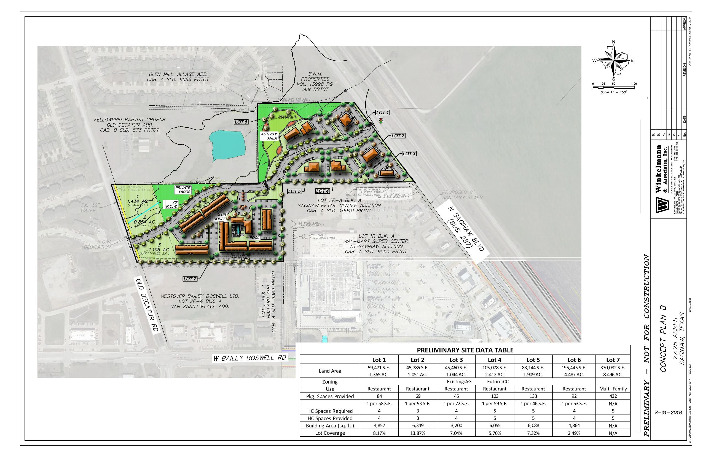
Local Economic News- The Beltmill and The Square Mixed-Used Developments
The Beltmill
Construction is already underway on the 115+ acre development that sits on the corner of Saginaw Blvd. and Bailey Boswell Rd (the site of the former Cranz Family Farm)
The development will feature a mix of retail shops, offices, new homes, apartments, senior living, and community activities
The city hopes the development will encourage more foot traffic in the Village Center and create a one-of-a-kind destination along Saginaw Blvd.
The Square
This 27+ acre development sits between Saginaw Blvd. and Old Decatur Road
It will also feature sit-down restaurants, retail, offices, and multi-family housing
The managing partner for The Square said it’s considering developing a shopping center to bring more business to the area
Sources: Multiple News Sources, Local EDC

Slide 4
State Enrollment Trends

Slide 5
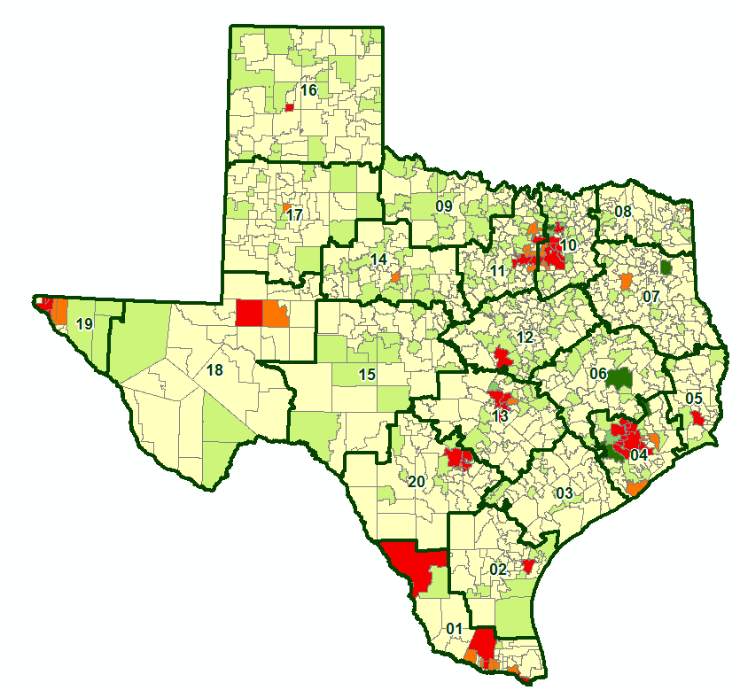
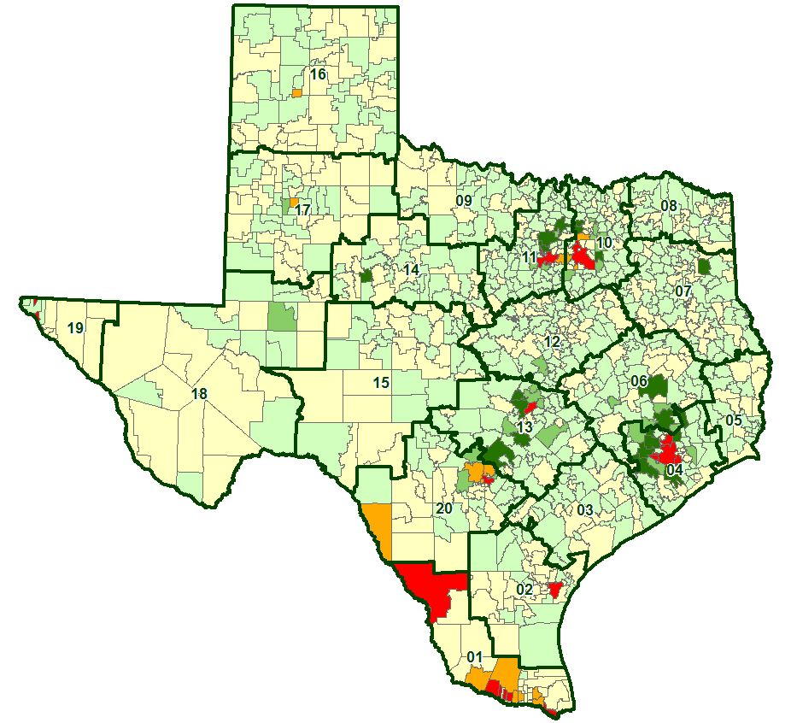
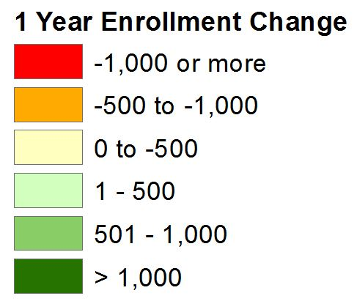
State Enrollment Trends
2020/21 State Enrollment
Total Enrollment 5,371,590
Total Growth -122,350
2021/22 State Enrollment
Total Enrollment 5,427,370
Total Growth 55,780

Slide 6
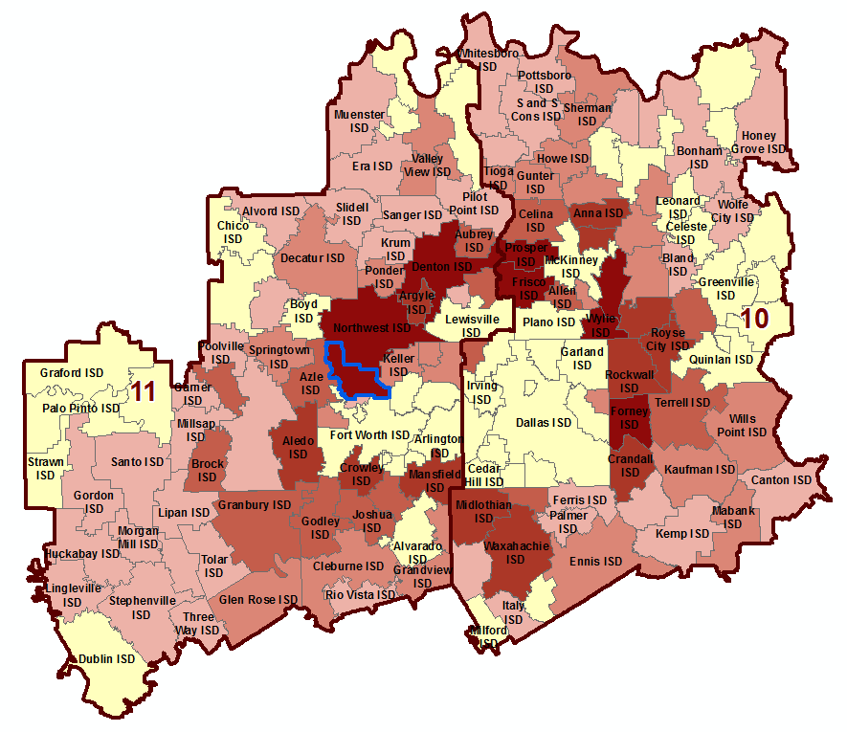
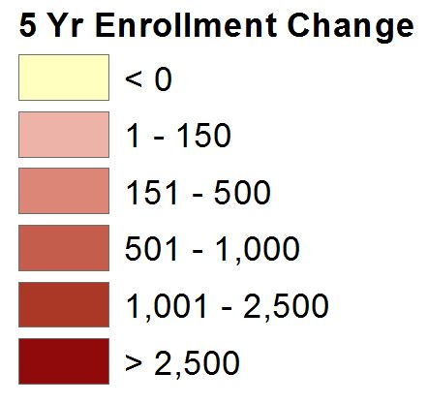
Region 10 & 11 Enrollment Trends
EMS ISD enrollment grew by 2,811 students between 2016/17 and 2021/22, an increase of 14.3%
2021/22 EMS ISD enrollment is up 1,219 students from 2020/21, an increase of 5.7%
Region 10 has seen an overall enrollment increase of 12,307 students from 2020/21, an increase of 1.6%
Region 11 enrollment has increased 1.8% from 2020/21, an increase of 10,005 students
EMS ISD

Slide 7
EMS ISD Housing Market Analysis
Home Sales by Transaction Type, 2010 – March 2022
Sources: Metrostudy & Tarrant County Deed Transactions

Slide 8
EMS ISD Housing Market Analysis
Average New vs. Existing Home Sale Price, 2010 – March 2022
 | Avg New Home Price | Avg Existing Home Price
2010 | $161,003 | $151,152
2011 | $168,397 | $163,737
2012 | $177,456 | $149,690
2013 | $189,753 | $169,032
2014 | $205,965 | $178,527
2015 | $224,715 | $182,696
2016 | $247,270 | $207,263
2017 | $262,235 | $218,517
2018 | $273,941 | $237,512
2019 | $272,368 | $247,786
2020 | $278,726 | $264,764
2021 | $322,444 | $297,710
2022 YTD | $405,627 | $318,015
Since 2010, the average new home price in EMS ISD has increased by $244,624, or 152%
Since 2010, the average existing home price in EMS has increased by $166,863 or 110%

Slide 9
DFW New Home Ranking Report
ISD Ranked by Annual Closings – 1Q22
Rank | District Name | Annual Starts | Annual Closings | Inventory | VDL | Future
1 | NORTHWEST ISD | 4,579 | 3,579 | 2,467 | 2,982 | 38,594
2 | DENTON ISD | 3,448 | 2,942 | 2,326 | 2,944 | 31,872
3 | PROSPER ISD | 2,970 | 2,688 | 2,021 | 2,777 | 21,907
4 | FORNEY ISD | 3,162 | 2,629 | 1,539 | 1,466 | 30,700
5 | FRISCO ISD | 1,823 | 2,043 | 1,236 | 1,402 | 9,889
6 | DALLAS ISD | 1,925 | 1,595 | 1,728 | 2,434 | 6,656
7 | PRINCETON ISD | 2,259 | 1,560 | 1,143 | 2,693 | 9,392
8 | ROYSE CITY ISD | 1,813 | 1,525 | 1,007 | 2,040 | 8,595
9 | CROWLEY ISD | 1,423 | 1,224 | 710 | 1,961 | 16,812
10 | EAGLE MT-SAGINAW ISD* | 1,192 | 1,151 | 692 | 2,063 | 19,526
11 | CRANDALL ISD | 1,293 | 1,136 | 516 | 1,492 | 13,844
12 | ROCKWALL ISD | 1,434 | 1,112 | 1,044 | 2,273 | 9,199
13 | MIDLOTHIAN ISD | 1,457 | 1,100 | 1,039 | 1,208 | 20,348
14 | ANNA ISD | 1,200 | 1,030 | 641 | 841 | 7,634
15 | MCKINNEY ISD | 1,358 | 1,009 | 873 | 1,683 | 14,404
16 | COMMUNITY ISD | 1,377 | 976 | 867 | 768 | 8,604
17 | MANSFIELD ISD | 1,275 | 962 | 961 | 1,739 | 6,557
18 | WAXAHACHIE ISD | 1,139 | 957 | 734 | 1,036 | 22,278
19 | AUBREY ISD | 1,175 | 943 | 810 | 1,292 | 5,733
20 | LEWISVILLE ISD | 1,194 | 918 | 963 | 1,568 | 2,373
* Based on additional Zonda Education housing research

Slide 10
District New Home Starts and Closings
Starts | 2016 | 2017 | 2018 | 2019 | 2020 | 2021 | 2022 |  | Closings | 2016 | 2017 | 2018 | 2019 | 2020 | 2021 | 2022
1Q | 177 | 179 | 389 | 351 | 530 | 321 | 319 |  | 1Q | 189 | 154 | 295 | 285 | 340 | 473 | 162
2Q | 223 | 368 | 411 | 439 | 593 | 356 |  |  | 2Q | 227 | 204 | 310 | 483 | 567 | 425
3Q | 243 | 412 | 293 | 442 | 514 | 318 |  |  | 3Q | 265 | 243 | 374 | 512 | 664 | 300
4Q | 124 | 224 | 517 | 401 | 580 | 199 |  |  | 4Q | 175 | 324 | 367 | 441 | 591 | 264
Total | 767 | 1,183 | 1,610 | 1,633 | 2,217 | 1,194 | 319 |  | Total | 856 | 925 | 1,346 | 1,721 | 2,162 | 1,462 | 162

Slide 11
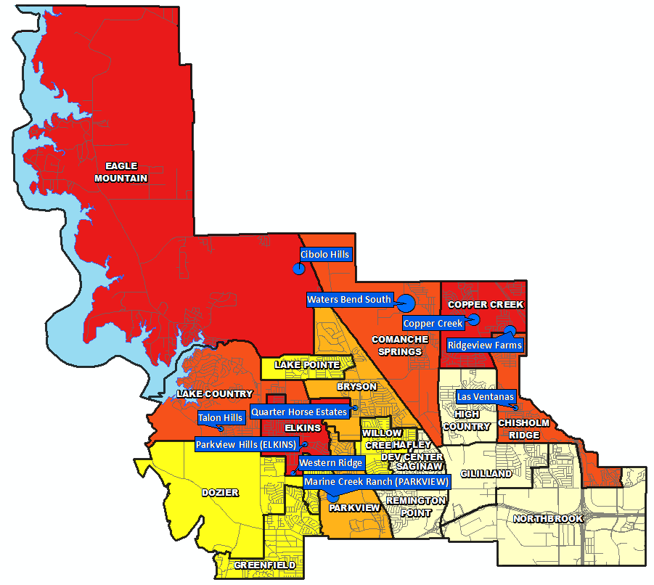
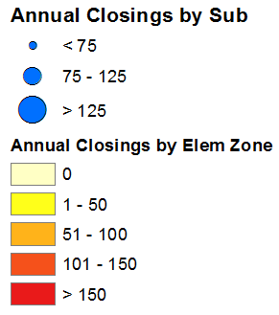
Annual Closing Distribution
Top 10 Subdivisions – 1Q22 (Ranked by Annual Closings)
Rank | Subdivision | Annual Closings | Quarter Closings | VDL | Future
1 | Waters Bend South | 140 | 10 | 115 | 185
2 | Copper Creek | 114 | 5 | 328 | 0
3 | Cibolo Hills | 110 | 40 | 203 | 343
4 | Marine Creek Ranch (PARKVIEW) | 96 | 3 | 85 | 432
5 | Ridgeview Farms | 80 | 22 | 103 | 0
6 | Western Ridge | 74 | 8 | 2 | 0
7 | Las Ventanas | 72 | 4 | 0 | 0
8 | Parkview Hills (ELKINS) | 72 | 14 | 5 | 0
9 | Talon Hills | 65 | 11 | 75 | 167
10 | Quarter Horse Estates | 61 | 0 | 0 | 0
 | TOTALS | 884 | 117 | 916 | 1,127

Slide 12
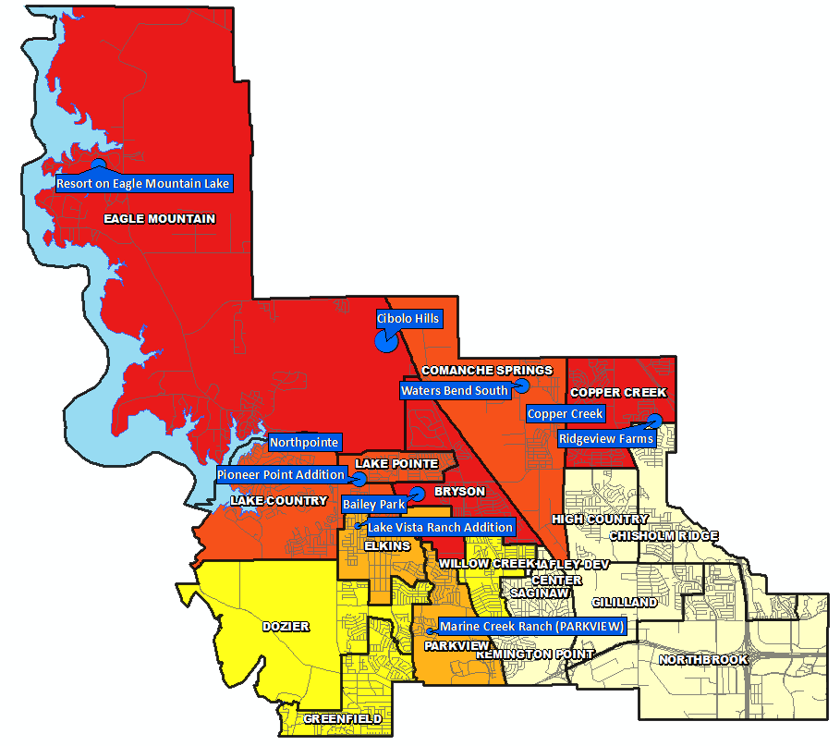
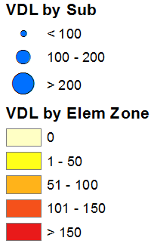
VDL Distribution
Top 10 Subdivisions – 1Q22 (Ranked by remaining VDL)
Rank | Subdivision | Annual Closings | Quarter Closings | VDL | Future
1 | Northpointe | 18 | 8 | 416 | 3,373
2 | Copper Creek | 114 | 5 | 328 | 0
3 | Cibolo Hills | 110 | 40 | 203 | 343
4 | Bailey Park | 0 | 0 | 185 | 134
5 | Resort on Eagle Mountain Lake | 15 | 4 | 122 | 30
6 | Waters Bend South | 140 | 10 | 115 | 185
7 | Pioneer Point Addition | 2 | 2 | 114 | 0
8 | Ridgeview Farms | 80 | 22 | 103 | 0
9 | Marine Creek Ranch (PARKVIEW) | 96 | 3 | 85 | 432
10 | Lake Vista Ranch Addition | 44 | 10 | 79 | 0
 | TOTALS | 619 | 104 | 1,750 | 4,497

Slide 13
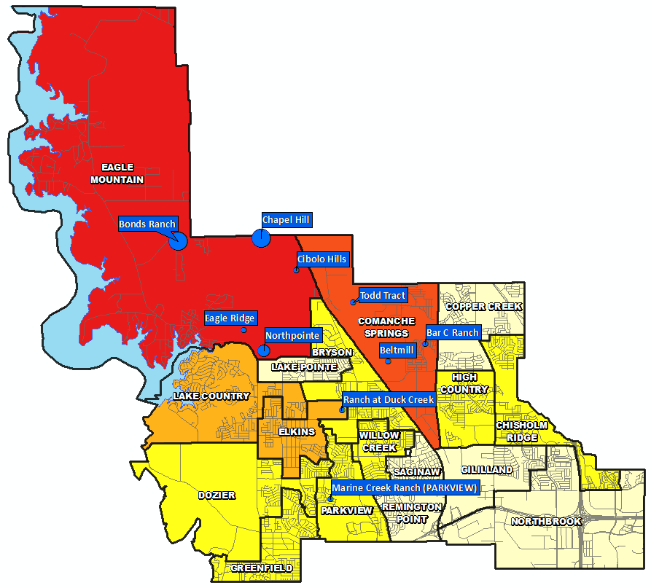
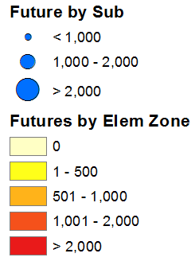
Futures Distribution
Top 10 Subdivisions – 1Q22 (Ranked by Future Inventory)
Rank | Subdivision | Annual Closings | Quarter Closings | VDL | Future
1 | Bonds Ranch | 0 | 0 | 0 | 6,137
2 | Chapel Hill | 0 | 0 | 2 | 4,713
3 | Northpointe | 18 | 8 | 416 | 3,373
4 | Eagle Ridge | 0 | 0 | 0 | 800
5 | Beltmill | 0 | 0 | 0 | 715
6 | Todd Tract | 0 | 0 | 0 | 663
7 | Marine Creek Ranch (PARKVIEW) | 96 | 3 | 85 | 432
8 | Ranch at Duck Creek | 0 | 0 | 0 | 361
9 | Cibolo Hills | 110 | 40 | 203 | 343
10 | Bar C Ranch | 0 | 0 | 17 | 341
 | TOTALS | 224 | 51 | 723 | 17,878

Slide 14
District Housing Overview by Elementary Zone
Elementary Zone | Annual Starts | Quarter Starts | Annual Closings | Quarter Closings | U/C | Inventory | VDL | Future
BRYSON | 15 | 0 | 61 | 0 | 0 | 0 | 185 | 134
CHISHOLM RIDGE | 52 | 0 | 118 | 4 | 0 | 0 | 0 | 339
COMANCHE SPRINGS | 176 | 108 | 140 | 10 | 163 | 166 | 132 | 1,904
COPPER CREEK | 188 | 9 | 194 | 27 | 67 | 71 | 431 | 0
DOZIER | 29 | 6 | 47 | 4 | 7 | 18 | 2 | 317
EAGLE MOUNTAIN | 315 | 92 | 170 | 61 | 176 | 188 | 864 | 15,717
ELKINS | 213 | 36 | 190 | 32 | 85 | 108 | 86 | 676
GILILLAND | 0 | 0 | 0 | 0 | 0 | 0 | 0 | 0
GREENFIELD | 1 | 0 | 1 | 1 | 1 | 1 | 3 | 226
HIGH COUNTRY | 0 | 0 | 0 | 0 | 0 | 0 | 0 | 47
LAKE COUNTRY | 53 | 10 | 107 | 12 | 28 | 29 | 133 | 588
LAKE POINTE | 23 | 7 | 7 | 2 | 11 | 22 | 114 | 0
NORTHBROOK | 0 | 0 | 0 | 0 | 0 | 0 | 0 | 0
PARKVIEW | 100 | 45 | 96 | 3 | 62 | 67 | 85 | 432
REMINGTON POINT | 0 | 0 | 0 | 0 | 0 | 0 | 0 | 0
SAGINAW | 0 | 0 | 0 | 0 | 0 | 0 | 0 | 0
WILLOW CREEK | 27 | 6 | 20 | 6 | 21 | 22 | 28 | 166
Grand Total | 1,192 | 319 | 1,151 | 162 | 621 | 692 | 2,063 | 20,546
 | Highest activity in the category
 | Second highest activity in the category
 | Third highest activity in the category

Slide 15
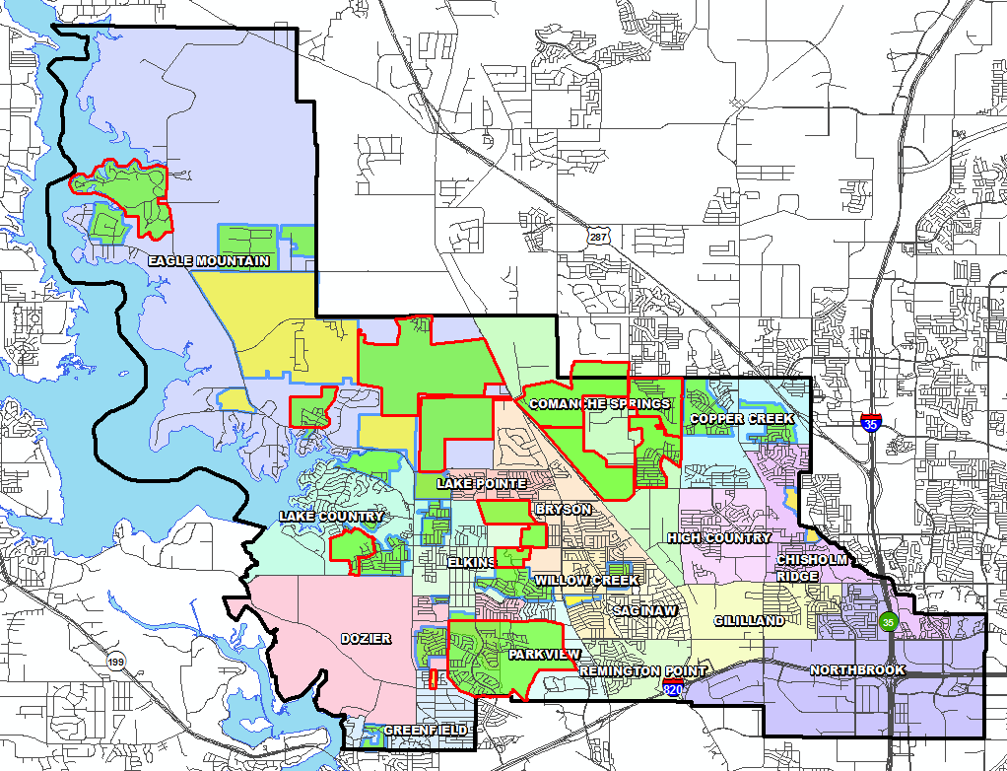
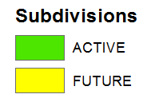

District Housing Overview
The district has 32 actively building subdivisions
Within EMS ISD there are 13 future subdivisions
Of these, groundwork is underway on more than 2,300 lots within 14 subdivisions

Slide 16
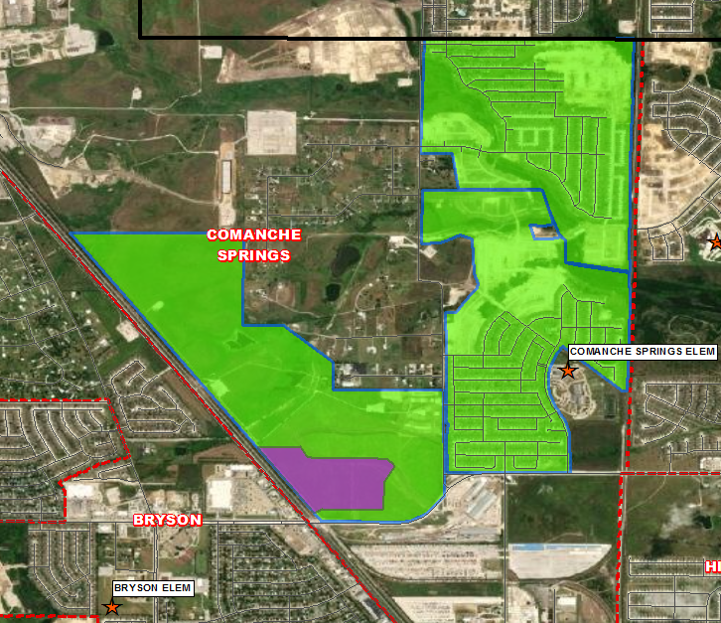
Residential Activity
Waters Bend South
1,207 total lots
185 future lots
814 occupied homes
115 VDL and 91 homes under construction
Started 104 homes and closed 140 homes in the last 12 months
Groundwork underway on all remaining lots
$280K-$365K
Comanche Springs Elementary
Beltmill Mixed-Use
715 total single-family lots
637 total multi-family units
Groundwork and infrastructure construction is underway
Comanche Springs Elementary
Bar C Ranch
1,249 total lots
341 future lots
818 occupied homes
17 VDL and 72 homes under construction
Groundwork is underway on all remaining lots
$230K-$400K
Comanche Springs Elementary

Slide 17
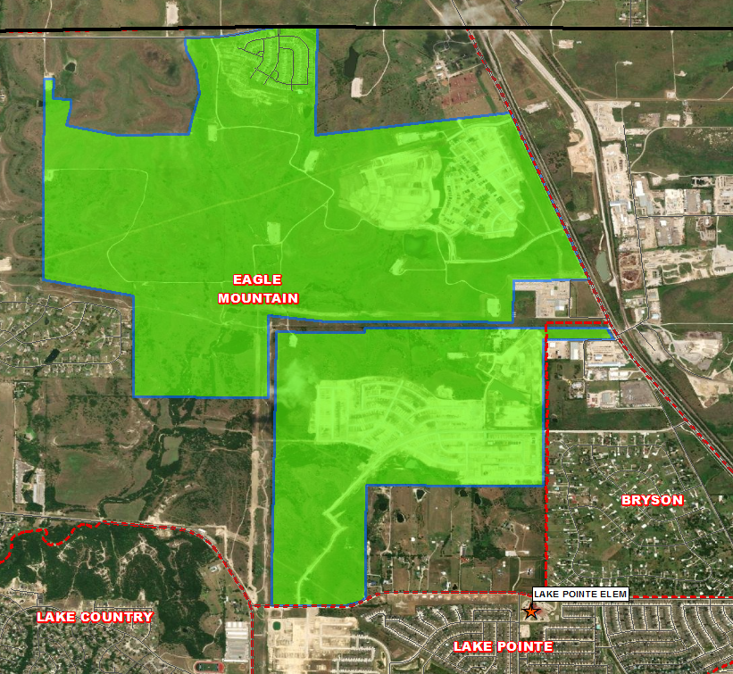
Residential Activity
Chapel Hill
4,919 total lots
4,713 future lots
201 occupied homes
2 VDL
Groundwork is underway on 156 additional lots
$250K-$300K
Eagle Mountain Elementary
Cibolo Hills
700 total lots
343 future lots
110 occupied homes
203 VDL and 41 homes under construction
Started 138 homes and closed 110 homes in the last 12 months
$335K-$535K
Eagle Mountain Elementary
Northpointe
3,835 total lots
3,325 future lots
18 occupied homes
416 VDL and 73 homes under construction
Started 94 homes and closed 18 homes in the last 12 months
Groundwork underway on 241 additional lots
$285K-$460K
Eagle Mountain Elementary

Slide 18
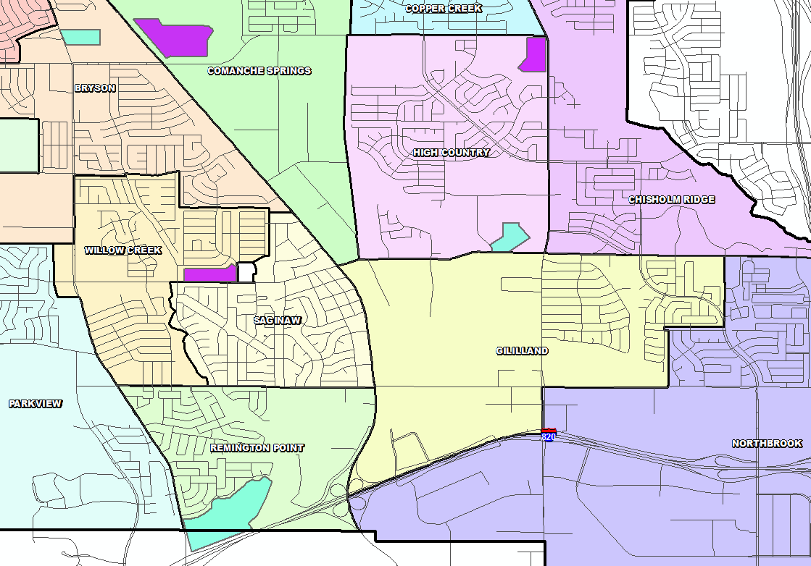
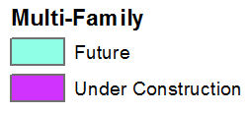
District Multi-Family Housing Overview
There are approx. 1,030 Multi-Family units under construction throughout the district
120 of those units are in an age-restricted complex
There are approx. 1,090 units in the planning stages

Slide 19
TEA Transfer Report
Transfers In From | 2016/17 | 2017/18 | 2018/19 | 2019/20 | 2020/21 | 2021/22 | 5 Year Change
Azle ISD | 36 | 37 | 35 | 39 | 23 | 25 | -11
Birdville ISD | 18 | 15 | 15 | 13 | 10 | 12 | -6
Fort Worth ISD | 35 | 31 | 38 | 27 | 36 | 39 | +4
Keller ISD | 39 | 35 | 31 | 24 | 28 | 25 | -14
Lake Worth ISD | 18 | 21 | 24 | 15 | 19 | 18 | 0
Northwest ISD | 64 | 43 | 51 | 37 | 45 | 68 | +4
Springtown ISD | 6 | 3 | 10 | 11 | 16 | 20 | +14
White Settlement ISD | 15 | 14 | 15 | 16 | 12 | 17 | +2
Total Transfers In* | 261 | 234 | 240 | 200 | 217 | 258 | -3
Transfers Out To | 2016/17 | 2017/18 | 2018/19 | 2019/20 | 2020/21 | 2021/22 | 5 Year Change
Azle ISD | 21 | 26 | 15 | 16 | 14 | 19 | +2
Birdville ISD | 66 | 84 | 88 | 112 | 118 | 135 | +69
Castleberry ISD | 15 | 10 | 12 | 19 | 19 | 32 | +17
FW Academy of Fine Arts | 21 | 27 | 22 | 20 | 21 | 19 | -2
Fort Worth ISD | 28 | 22 | 36 | 45 | 29 | 12 | -16
Grapevine-Colleyville ISD | 16 | 18 | 15 | 23 | 20 | 15 | -1
Hallsville ISD | - | - | 25 | 39 | 53 | 66 | +66
High Point Academy | 74 | 83 | 85 | 78 | 73 | 53 | -21
HEB ISD | 15 | 14 | 16 | 15 | 25 | 20 | +5
Idea Public Schools | - | - | - | 30 | 47 | 33 | +33
International Leadership of Texas | 266 | 1,087 | 1,165 | 1,199 | 1,299 | 1,312 | +1,046
Keller ISD | 71 | 80 | 119 | 136 | 179 | 123 | +52
Lake Worth ISD | 65 | 43 | 39 | 41 | 40 | 51 | -14
Northwest ISD | 105 | 107 | 117 | 105 | 108 | 119 | +14
White Settlement ISD | 37 | 32 | 35 | 35 | 33 | 46 | +9
Total Transfers Out* | 911 | 1,767 | 1,897 | 2,043 | 2,251 | 2,283 | +1,372
* Totals include additional districts due to TEA rounding rules

Slide 20
Ten Year Forecast by Grade Level
 | EE | PK | K | 1st | 2nd | 3rd | 4th | 5th | 6th | 7th | 8th | 9th | 10th | 11th | 12th | Total | Total Growth | Total %
2017/18 | 93 | 431 | 1,255 | 1,340 | 1,328 | 1,389 | 1,518 | 1,535 | 1,466 | 1,489 | 1,467 | 1,620 | 1,578 | 1,417 | 1,391 | 19,317
2018/19 | 110 | 413 | 1,357 | 1,396 | 1,400 | 1,398 | 1,498 | 1,639 | 1,645 | 1,597 | 1,546 | 1,621 | 1,632 | 1,491 | 1,311 | 20,054 | 737 | 3.82%
2019/20 | 112 | 398 | 1,413 | 1,465 | 1,464 | 1,454 | 1,490 | 1,601 | 1,742 | 1,776 | 1,671 | 1,777 | 1,655 | 1,591 | 1,415 | 21,024 | 970 | 4.84%
2020/21 | 117 | 342 | 1,358 | 1,462 | 1,522 | 1,497 | 1,493 | 1,566 | 1,637 | 1,809 | 1,778 | 1,817 | 1,749 | 1,619 | 1,479 | 21,245 | 221 | 1.05%
2021/22 | 69 | 533 | 1,477 | 1,576 | 1,594 | 1,599 | 1,589 | 1,539 | 1,687 | 1,739 | 1,871 | 2,088 | 1,850 | 1,667 | 1,455 | 22,333 | 1,088 | 5.12%
2022/23 | 58 | 657 | 1,570 | 1,653 | 1,670 | 1,702 | 1,709 | 1,704 | 1,709 | 1,812 | 1,826 | 2,074 | 2,101 | 1,761 | 1,543 | 23,549 | 1,216 | 5.44%
2023/24 | 61 | 683 | 1,643 | 1,738 | 1,748 | 1,748 | 1,798 | 1,808 | 1,894 | 1,821 | 1,919 | 2,029 | 2,061 | 2,004 | 1,633 | 24,589 | 1,040 | 4.42%
2024/25 | 63 | 712 | 1,718 | 1,791 | 1,828 | 1,855 | 1,854 | 1,898 | 1,955 | 2,006 | 1,898 | 2,110 | 2,017 | 1,973 | 1,852 | 25,530 | 941 | 3.83%
2025/26 | 65 | 721 | 1,770 | 1,885 | 1,869 | 1,920 | 1,939 | 1,941 | 2,042 | 2,048 | 2,068 | 2,089 | 2,096 | 1,926 | 1,822 | 26,201 | 671 | 2.63%
2026/27 | 68 | 746 | 1,848 | 1,947 | 1,977 | 1,971 | 2,030 | 2,020 | 2,065 | 2,136 | 2,104 | 2,272 | 2,067 | 2,004 | 1,778 | 27,032 | 831 | 3.17%
2027/28 | 71 | 767 | 1,919 | 2,035 | 2,028 | 2,066 | 2,063 | 2,115 | 2,112 | 2,159 | 2,186 | 2,311 | 2,253 | 1,977 | 1,852 | 27,913 | 881 | 3.26%
2028/29 | 73 | 782 | 1,973 | 2,089 | 2,111 | 2,107 | 2,157 | 2,147 | 2,215 | 2,214 | 2,199 | 2,365 | 2,263 | 2,152 | 1,826 | 28,673 | 760 | 2.72%
2029/30 | 76 | 806 | 2,053 | 2,137 | 2,155 | 2,185 | 2,179 | 2,233 | 2,249 | 2,318 | 2,257 | 2,402 | 2,332 | 2,164 | 1,987 | 29,532 | 858 | 2.99%
2030/31 | 77 | 816 | 2,088 | 2,211 | 2,201 | 2,234 | 2,265 | 2,250 | 2,341 | 2,352 | 2,364 | 2,460 | 2,366 | 2,229 | 1,999 | 30,253 | 722 | 2.44%
2031/32 | 79 | 832 | 2,142 | 2,259 | 2,271 | 2,264 | 2,315 | 2,329 | 2,357 | 2,452 | 2,398 | 2,570 | 2,419 | 2,263 | 2,059 | 31,008 | 754 | 2.49%
Yellow box = largest grade per year
Green box = second largest grade per year

Slide 21
Ten Year Forecast by Elementary Campus
 |  | Fall | ENROLLMENT PROJECTIONS
Campus | Capacity | 2021/22 | 2022/23 | 2023/24 | 2024/25 | 2025/26 | 2026/27 | 2027/28 | 2028/29 | 2029/30 | 2030/31 | 2031/32
HAFLEY DEVELOPMENT CENTER | 512 | 378 | 302 | 326 | 351 | 368 | 394 | 417 | 435 | 461 | 473 | 491
BRYSON ELEMENTARY | 692 | 572 | 610 | 623 | 643 | 656 | 678 | 698 | 716 | 721 | 729 | 732
CHISHOLM RIDGE ELEMENTARY | 758 | 647 | 705 | 708 | 728 | 752 | 758 | 773 | 786 | 797 | 806 | 823
COMANCHE SPRINGS ELEMENTARY | 736 | 547 | 687 | 820 | 970 | 1,067 | 1,179 | 1,259 | 1,279 | 1,291 | 1,289 | 1,290
COPPER CREEK ELEMENTARY | 758 | 547 | 610 | 675 | 697 | 709 | 750 | 754 | 742 | 743 | 734 | 733
DOZIER ELEMENTARY | 782 | 666 | 722 | 746 | 789 | 819 | 825 | 840 | 841 | 843 | 827 | 820
EAGLE MOUNTAIN ELEMENTARY | 670 | 417 | 515 | 597 | 699 | 824 | 976 | 1,187 | 1,425 | 1,632 | 1,884 | 2,116
ELKINS ELEMENTARY | 645 | 578 | 634 | 667 | 692 | 716 | 717 | 712 | 711 | 714 | 716 | 719
GILILLAND ELMENTARY | 564 | 503 | 504 | 513 | 509 | 521 | 527 | 520 | 511 | 506 | 501 | 495
GREENFIELD ELEMENTARY | 779 | 707 | 718 | 726 | 739 | 748 | 761 | 760 | 771 | 784 | 794 | 809
HIGH COUNTRY ELEMENTARY | 670 | 570 | 639 | 646 | 663 | 655 | 628 | 630 | 626 | 641 | 650 | 659
LAKE COUNTRY ELEMENTARY | 758 | 684 | 686 | 695 | 716 | 725 | 743 | 779 | 836 | 886 | 897 | 910
LAKE POINTE ELEMENTARY | 758 | 587 | 650 | 694 | 692 | 691 | 710 | 730 | 740 | 759 | 768 | 780
NORTHBROOK ELEMENTARY | 671 | 544 | 566 | 560 | 588 | 592 | 596 | 606 | 604 | 602 | 606 | 611
PARKVIEW ELEMENTARY | 693 | 557 | 634 | 663 | 682 | 715 | 758 | 774 | 784 | 778 | 785 | 797
REMINGTON POINT ELEMENTARY | 714 | 541 | 562 | 565 | 547 | 532 | 563 | 584 | 584 | 601 | 616 | 625
SAGINAW ELEMENTARY | 423 | 333 | 331 | 331 | 332 | 319 | 328 | 324 | 325 | 330 | 332 | 333
WILLOW CREEK ELEMENTARY | 662 | 598 | 647 | 673 | 682 | 700 | 715 | 716 | 724 | 733 | 735 | 748
ELEMENTARY TOTALS | 12,245 | 9,976 | 10,723 | 11,228 | 11,719 | 12,110 | 12,606 | 13,063 | 13,439 | 13,823 | 14,142 | 14,490
Elementary Percent Change |  | 6.62% | 7.49% | 4.71% | 4.37% | 3.34% | 4.10% | 3.63% | 2.88% | 2.85% | 2.31% | 2.46%
Elementary Absolute Change |  | 619 | 747 | 505 | 491 | 391 | 496 | 457 | 376 | 383 | 320 | 347
 | 95% of capacity
 | 105% of capacity

Slide 22
Ten Year Forecast by Secondary Campus
 | History |  | Fall | ENROLLMENT PROJECTIONS
Campus | Capacity | 2020/21 | 2021/22 | 2022/23 | 2023/24 | 2024/25 | 2025/26 | 2026/27 | 2027/28 | 2028/29 | 2029/30 | 2030/31 | 2031/32
CREEKVIEW MIDDLE SCHOOL | 1,078 | 800 | 829 | 842 | 921 | 956 | 949 | 926 | 922 | 925 | 920 | 932 | 943
HIGHLAND MIDDLE SCHOOL | 1,050 | 824 | 757 | 777 | 845 | 897 | 890 | 915 | 928 | 957 | 921 | 924 | 906
PRAIRIE VISTA MIDDLE SCHOOL | 1,002 | 844 | 884 | 899 | 926 | 961 | 1,074 | 1,136 | 1,205 | 1,255 | 1,331 | 1,350 | 1,343
WAYSIDE MIDDLE SCHOOL | 1,002 | 964 | 1,055 | 1,066 | 1,094 | 1,108 | 1,211 | 1,318 | 1,372 | 1,432 | 1,535 | 1,676 | 1,813
WILLKIE MIDDLE SCHOOL | 1,002 | 712 | 701 | 743 | 816 | 842 | 894 | 899 | 942 | 956 | 965 | 1,000 | 1,023
MARINE CREEK MIDDLE SCHOOL | 1,200 | 1,076 | 1,070 | 1,019 | 1,031 | 1,094 | 1,139 | 1,110 | 1,087 | 1,102 | 1,151 | 1,174 | 1,178
MIDDLE SCHOOL TOTALS | 6,334 | 5,220 | 5,296 | 5,346 | 5,633 | 5,858 | 6,157 | 6,304 | 6,456 | 6,627 | 6,823 | 7,056 | 7,206
Middle School Percent Change |  | 0.64% | 1.46% | 0.94% | 5.37% | 3.99% | 5.10% | 2.39% | 2.41% | 2.65% | 2.96% | 3.41% | 2.13%
Middle School Absolute Change |  | 33 | 76 | 50 | 287 | 225 | 299 | 147 | 152 | 171 | 196 | 233 | 150
BOSWELL HIGH SCHOOL |  | 2,265 | 2,412 | 2,588 | 2,678 | 2,875 | 2,922 | 2,982 | 3,082 | 3,093 | 3,203 | 3,278 | 3,359
SAGINAW HIGH SCHOOL |  | 2,001 | 2,164 | 2,253 | 2,315 | 2,311 | 2,296 | 2,365 | 2,481 | 2,611 | 2,722 | 2,817 | 2,936
CHISHOLM TRAIL HIGH SCHOOL |  | 2,288 | 2,364 | 2,518 | 2,614 | 2,646 | 2,595 | 2,654 | 2,710 | 2,782 | 2,840 | 2,839 | 2,896
WATSON HIGH SCHOOL |  | 92 | 108 | 108 | 108 | 108 | 108 | 108 | 108 | 108 | 108 | 108 | 108
HIGH SCHOOL TOTALS |  | 6,646 | 7,048 | 7,467 | 7,715 | 7,940 | 7,921 | 8,109 | 8,381 | 8,594 | 8,873 | 9,042 | 9,299
High School Percent Change |  | 3.65% | 6.05% | 5.94% | 3.32% | 2.92% | -0.24% | 2.37% | 3.35% | 2.54% | 3.25% | 1.90% | 2.84%
High School Absolute Change |  | 234 | 402 | 419 | 248 | 225 | -19 | 188 | 272 | 213 | 279 | 169 | 257
TARRANT COUNTY JJAEP |  | 1 | 0 | 0 | 0 | 0 | 0 | 0 | 0 | 0 | 0 | 0 | 0
ALTERNATIVE DISCIPLINE SCHOOL |  | 21 | 13 | 13 | 13 | 13 | 13 | 13 | 13 | 13 | 13 | 13 | 13
ALTERNATIVE SCHOOL TOTALS |  | 22 | 13 | 13 | 13 | 13 | 13 | 13 | 13 | 13 | 13 | 13 | 13
DISTRICT TOTALS |  | 21,245 | 22,333 | 23,549 | 24,589 | 25,530 | 26,201 | 27,032 | 27,913 | 28,673 | 29,532 | 30,253 | 31,008
District Percent Change |  | 1.05% | 5.12% | 5.44% | 4.42% | 3.83% | 2.63% | 3.17% | 3.26% | 2.72% | 2.99% | 2.44% | 2.49%
District Absolute Change |  | 221 | 1,088 | 1,216 | 1,040 | 941 | 671 | 831 | 881 | 760 | 858 | 722 | 754
 | 95% of capacity
 | 105% of capacity

Slide 23
Key Takeaways
EMS ISD enrollment grew by 2,811 students between 2016/17 and 2021/22, an increase of 14.3%
2021/22 EMS ISD enrollment is up 1,219 students from 2020/21, an increase of 5.7%
The district has 32 actively building subdivisions and 16 future subdivisions in the planning stages
Of these, groundwork is underway on more than 2,300 lots within 12 subdivisions
There are approx. 1,030 Multi-Family units under construction in the district
EMS ISD can expect to enroll more than 27,000 students by 2026/27 and more than 31,000 by 2031/32

